Slide 1
Heuristic Search
It pays to guess…
Reading: Chapter 4

Slide 2
Search
We have seen many examples of tree-search
  BFS, DFS, IDS
Key idea is order of node expansion
In this lecture:
  Greedy best-first search, A*
  Best first is not really the best!

Slide 3
Best-first search
Idea: use an evaluation function f(n) for each node
  estimate of "desirability"
  Expand most desirable unexpanded node
Implementation:
Order the nodes in fringe in decreasing order of desirability
Special cases:
  greedy best-first search
  A* search

Slide 4
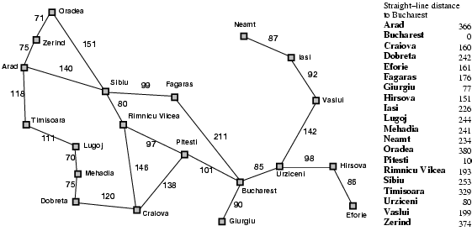
Romania with step costs in km

Slide 5
Greedy best-first search
Evaluation function f(n) = h(n) (heuristic)
= estimate of cost from n to goal
e.g., h_{SLD}(n) = straight-line distance from n to Bucharest
Greedy best-first search expands the node that appears to be closest to goal

Slide 6

Greedy best-first search example

Slide 7
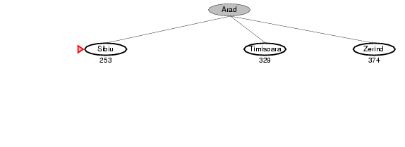
Greedy best-first search example

Slide 8
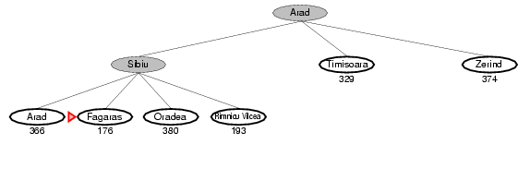
Greedy best-first search example

Slide 9
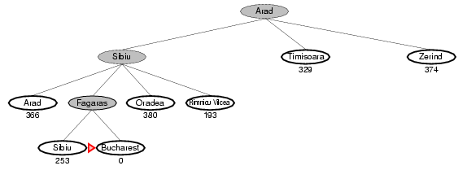
Greedy best-first search example

Slide 10
Properties of greedy best-first search
Complete? No – can get stuck in loops like depth first if heuristic is bad
Time? O(b^{m}), but a good heuristic can give dramatic improvement
Space? O(b^{m}) -- keeps all nodes in memory
Optimal? No

Slide 11
A* search
Idea: avoid expanding paths that are already expensive
Evaluation function f(n) = g(n) + h(n)
g(n) = cost so far to reach n
h(n) = estimated cost from n to goal
f(n) = estimated total cost of path through n to goal

Slide 12

A* search example

Slide 13
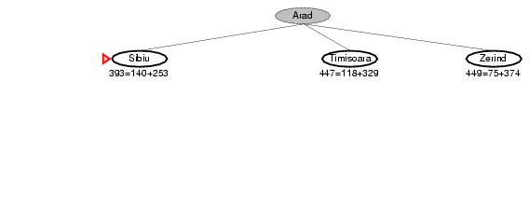
A* search example

Slide 14
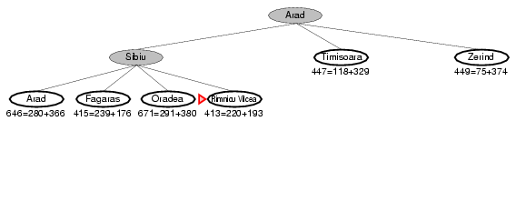
A* search example

Slide 15
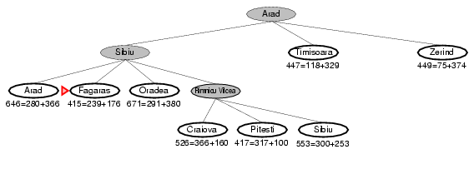
A* search example

Slide 16
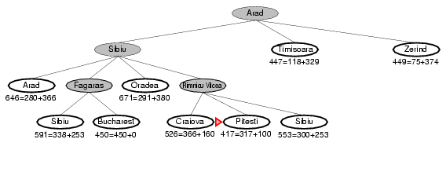
A* search example

Slide 17
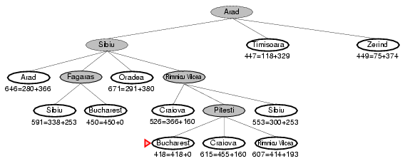
A* search example

Slide 18
Admissible heuristics
A heuristic h(n) is admissible if for every node n, h(n) ≤ h*(n), where h*(n) is the true cost to reach the goal state from n.
An admissible heuristic never overestimates the cost to reach the goal, i.e., it is optimistic
Example: h_{SLD}(n) (never overestimates the actual road distance)
Theorem: If h(n) is admissible, A* using TREE-SEARCH is optimal

Slide 19
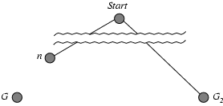
Optimality of A* (proof)
Suppose some suboptimal goal state G₂ has been generated and is in the fringe. Let n be an unexpanded node in the fringe such that n is on a shortest path to an optimal goal G with true cost C*.
f(n) = g(n)+h(n)
(from h(x)≤g(x) and g(G) =C*)
f(n) ≤ C*
f(G₂) = g(G₂)+h(G₂)
(from h(x)≤g(x) and G₂ is a goal state)
f(G₂)=g(G₂)
(from suboptimality of G₂)
f(G₂)>C*
∴ f(n) ≤ f(G₂), and A* will never select G₂ for expansion

Slide 20
But,
That proof doesn’t hold for GRAPH-SEARCH
A* might discard the optimal path to a repeated state if it is not the first one generated
If the cost for any action was a constant, this wouldn’t be a problem
OR, if we can guarantee that the first path found to a repeated node was the best path to that node
We can guarantee this if we impose an extra requirement on the heuristic

Slide 21
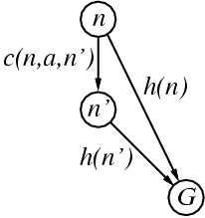
Consistent heuristics
A heuristic is consistent (or monotonic) if for every node n, every successor n' of n generated by any action a
h(n) ≤ c(n,a,n') + h(n')
If h is consistent, we have
f(n') = g(n') + h(n')
= g(n) + c(n,a,n') + h(n')
≥ g(n) + h(n)
= f(n)
i.e., f(n) is non-decreasing along any path.
Theorem: If h(n) is consistent, A* using GRAPH-SEARCH is optimal

Slide 22
Optimality follows
Given f(n) is non-decreasing along any path
The sequence of nodes expanded by A* is in nondecreasing order of f(n)
Hence the first goal to be selected for expansion must be an optimal solution (since all the latter nodes are at least as expensive).

Slide 23
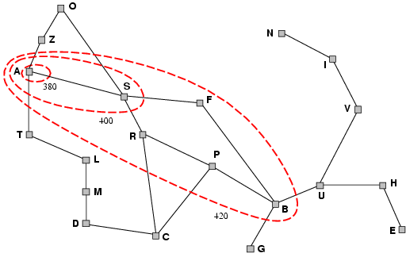
Optimality of A*
A* expands nodes in order of increasing f value
Gradually adds "f-contours" of nodes
Contour i has all nodes with f=f_{i}, where f_{i} < f_{i+1}

Slide 24
Characteristics of A*
If C* is the cost of the optimal path
A* expands all nodes s.t. f(n)<C*
A* will possibly expand nodes on the right of the ‘goal contour’ (f(n)=C*), before finding the goal node
A* never expands nodes with f(n)>C*

Slide 25
Characteristics of A*
Does efficient pruning
  Bits of the tree for which f(n) > f(G) are not expanded
Is optimally efficient
  No other algorithm is guaranteed to expand fewer nodes than A* (unless there many tie-breaking nodes)

Slide 26
Properties of A*
Complete? Yes (unless there are infinitely many nodes with f ≤ f(G) )
Time? Exponential (in length of optimal solution)
Space? Keeps all (expanded) nodes in memory
Optimal? Yes

Slide 27
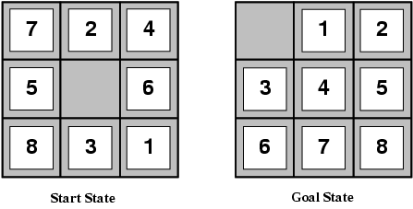
Admissible heuristics
E.g., for the 8-puzzle:
h₁(n) = number of misplaced tiles
h₂(n) = total Manhattan distance
(i.e., no. of squares from desired location of each tile)
h₁(S) = ?
h₂(S) = ?

Slide 28
Admissible heuristics
E.g., for the 8-puzzle:
h₁(n) = number of misplaced tiles
h₂(n) = total Manhattan distance
(i.e., no. of squares from desired location of each tile)
h₁(S) = ? 8
h₂(S) = ? 3+1+2+2+2+3+3+2 = 18

Slide 29
Dominance
If h₂(n) ≥ h₁(n) for all n (both admissible)
then h₂ dominates h₁
h₂ is better for search
Typical search costs (average number of nodes expanded = effective branching factor):
d=12 IDS = 3,644,035 nodes
A*(h₁) = 227 nodes
A*(h₂) = 73 nodes
d=24 IDS = too many nodes
A*(h₁) = 39,135 nodes
A*(h₂) = 1,641 nodes

Slide 30
More on heuristics
Often impractical to find optimal solution
  Variants of A* that find sub-optimal solutions quickly
  ‘More accurate’ heuristics that are not strictly admissable
How do you create a heuristic?

Slide 31
Relaxed problems
A problem with fewer restrictions on the actions is called a relaxed problem
The cost of an optimal solution to a relaxed problem is an admissible heuristic for the original problem
If the rules of the 8-puzzle are relaxed so that a tile can move anywhere, then h₁(n) gives the shortest solution
If the rules are relaxed so that a tile can move to any adjacent square, then h₂(n) gives the shortest solution

Slide 32
Summary
Good heuristics help!
  Bad heuristics also help (but not much)
A* really is optimal in many ways (but optimality is often impractical)
Always remember:
  (naive) Search space is usually much, much, much, much, bigger than it first looks

